Slide 1

Greater Cambridge Energy Program
(GCEP)
Community Update
October 4, 2023

Slide 2
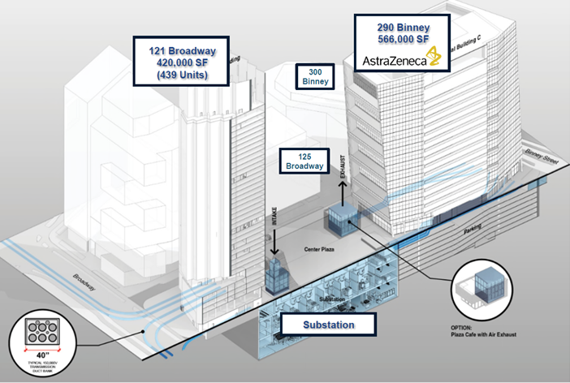
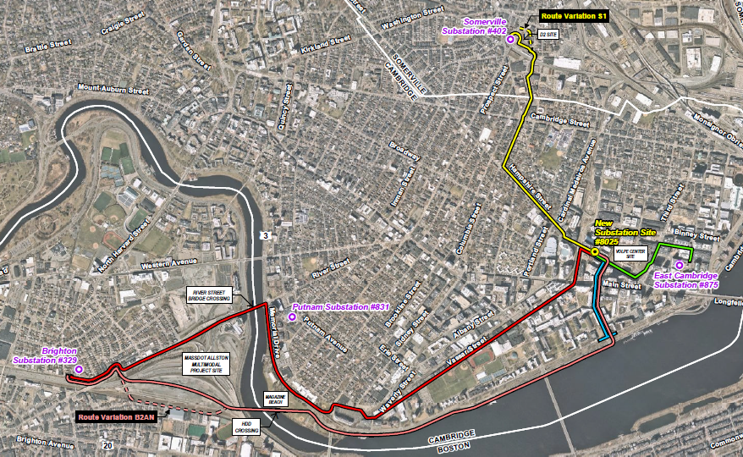
Program Details Refresher
Proposal for New Station, New Transmission Lines
Proposed underground substation and adjacent buildings
(Courtesy BXP)
New underground substation in Kendall Square
Integrated into Boston Properties redevelopment plans
Public open space above substation between residential and commercial buildings
Preferred line routes as submitted to EFSB March 2022
New underground transmission lines
  Five new duct banks housing eight new 115-kilovolt (“kV”) underground transmission lines.
  Interconnects with Allston/Brighton, Cambridge and Somerville substations.

Slide 3


Regulatory Timeline & Next Steps
MEPA ENF¹ submittal
Public comment hearing
Public comment hearing on hybrid route
12/15/2021
06/28/2022
11/10/2022
03/10/2022
07/20/2022
EFSB² submittal
EFSB² requests Eversource evaluate a hybrid route from Kendall Sq. to Somerville
Q2 2024
2024-2028
Anticipated EFSB² decision
Construction³
10/16/2023
Q2/Q3 2024
2028-2029
EFSB begins evidentiary hearings
Award contracts
Projected in-service date⁴
1. Massachusetts Environmental Policy Act Environmental Notification Form
2. Energy Facilities Siting Board
3. Subject to change and pending receipt of all approvals / permits
4. Various components

Slide 4
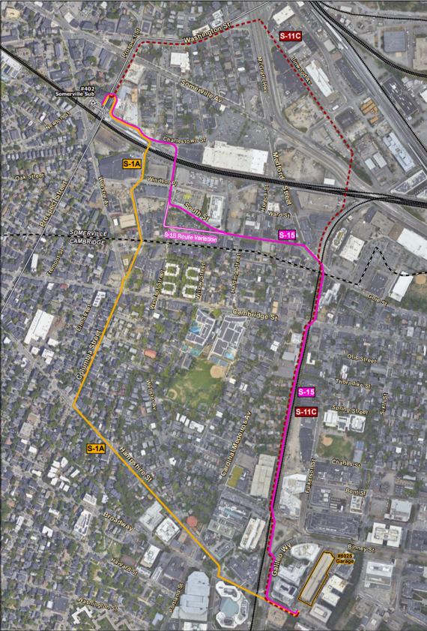
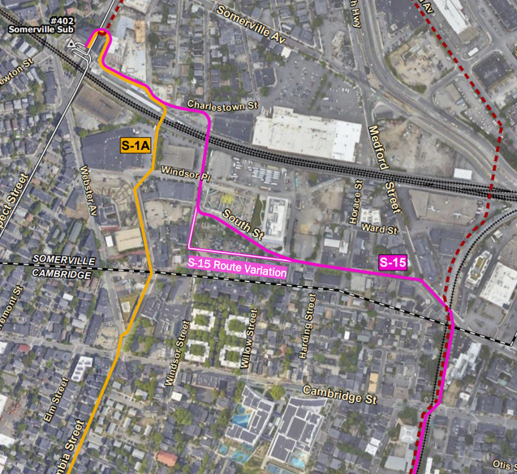
Update: Primary Route from Kendall Sq. to Union Sq.
Hybrid route S15 follows RR track / Grand Junction Corridor, South Street
South Street Detail
Original preferred route S-1A and original noticed alternative route S-11C introduced in EFSB filing on March 10, 2022.
New, primary route S-15 proposed September 2023.
Primary S15 Route
(Solid Pink Line)

Slide 5
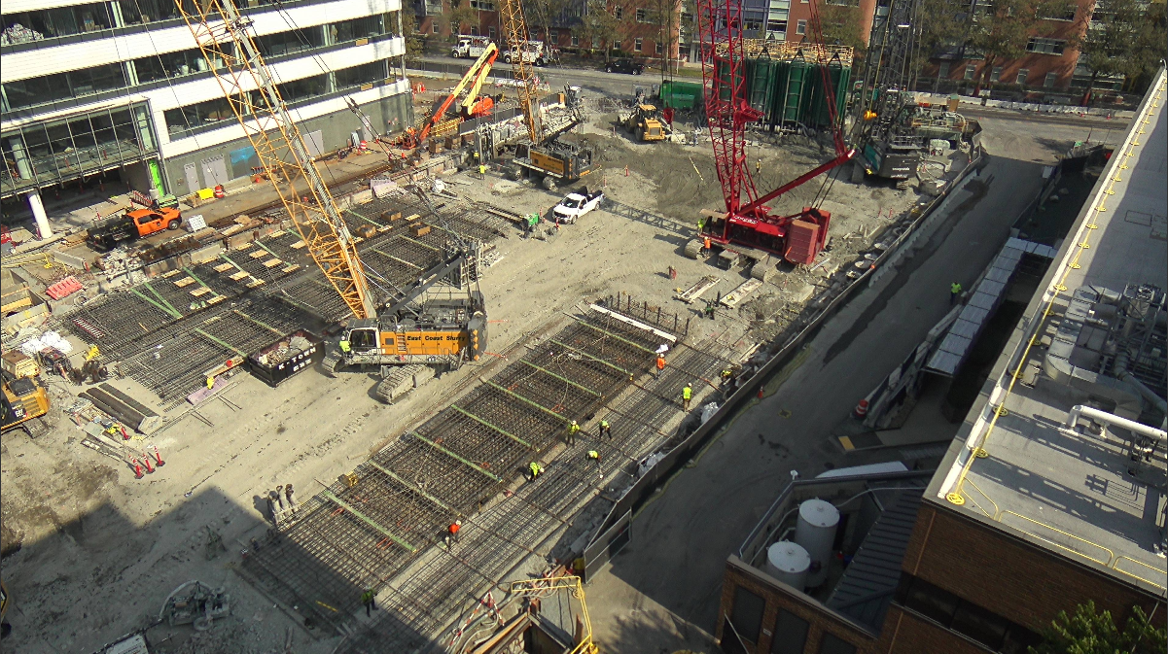
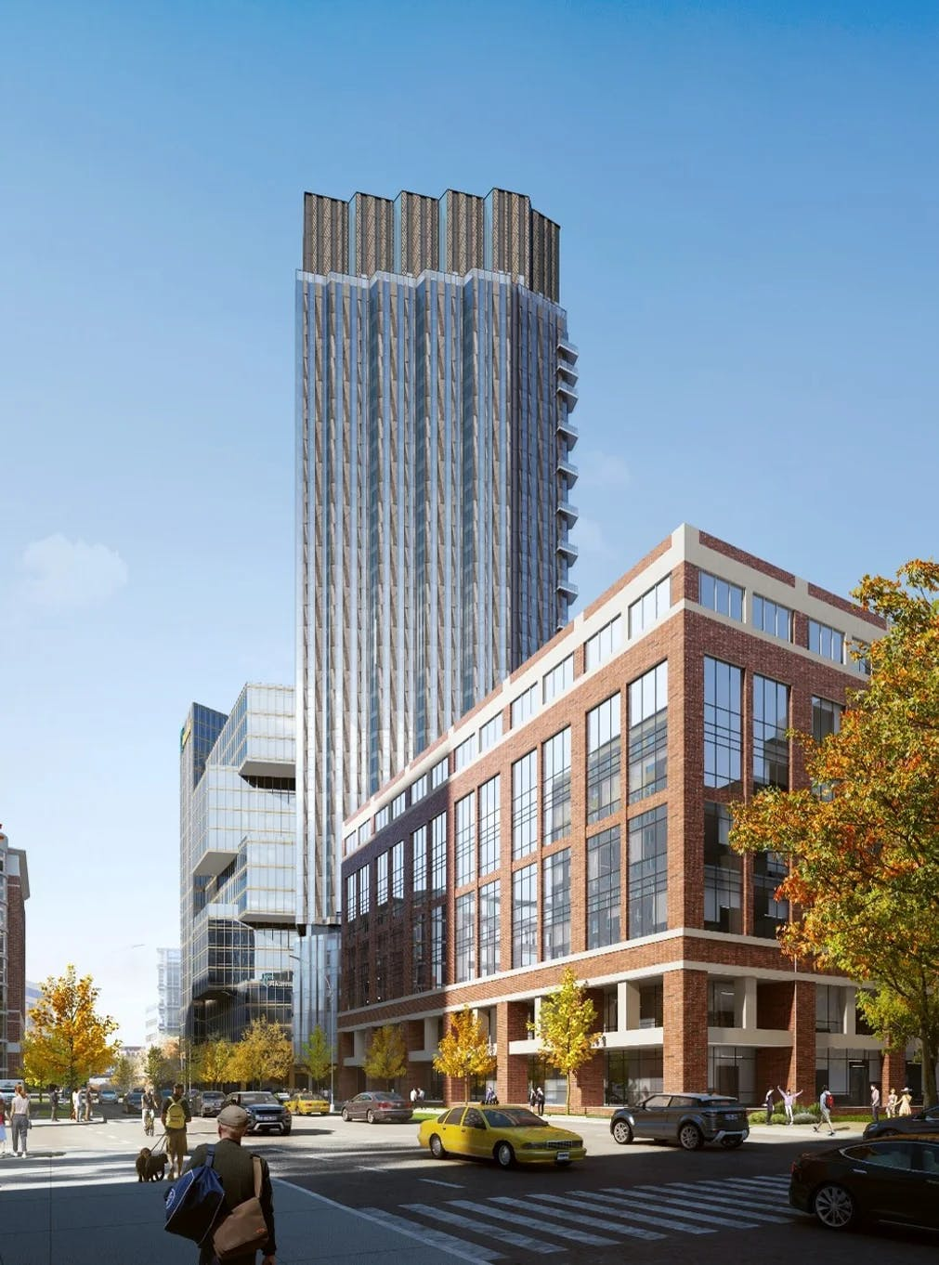
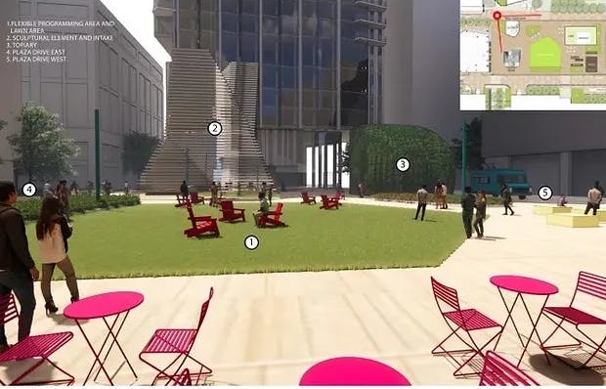
Boston Properties Update
March 2023 Demolition of Blue Garage completed.
2023 - 2027
Site work activities and construction of 121 Broadway and 290 Binney Street.
~2025-2028* Substation construction and equipment installation by Eversource.
Site progress photo Sept. 2023 (Courtesy BXP)
* Pending EFSB Approval
Plaza and building conceptual renderings (Courtesy BXP)

Slide 6
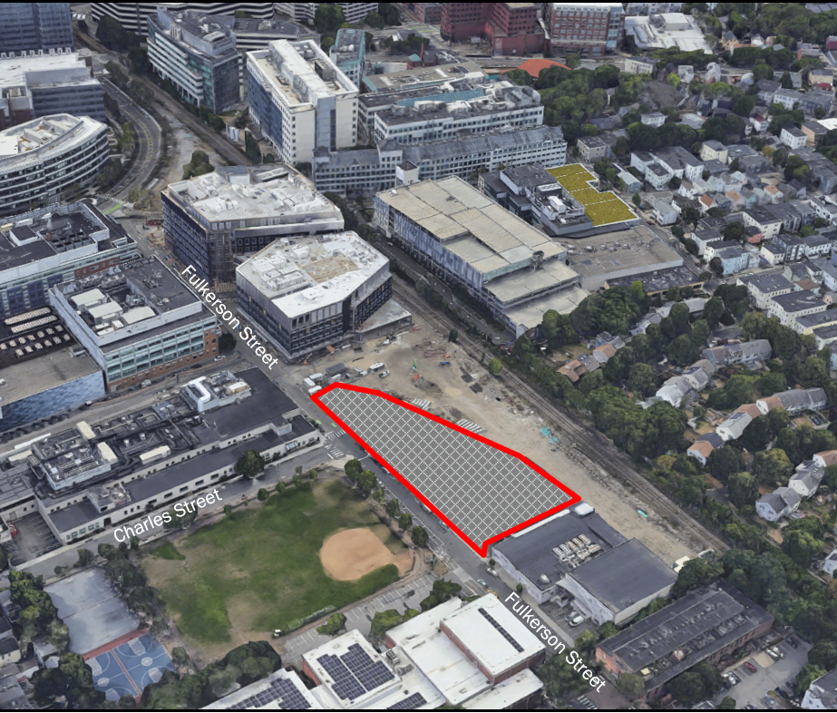
135 Fulkerson History
Commitments Made, Commitments Kept
2020 – City of Cambridge, Eversource, Boston Properties, and Alexandria Properties reached an agreement that resulted in the relocation of the proposed substation out of the East Cambridge neighborhood into the Kendall Square MXD district.
As part of the Grand Junction Zoning, Alexandria committed to purchasing the parcel from Eversource and transferring it to the City for public use.
~ 2024* – Q3 City anticipates purchasing 135 Fulkerson Street from Eversource with the $12,929,000 Alexandria placed in escrow. No appropriation of city funds will be required.
~ 2024-2030* - Eversource anticipates using the 135 Fulkerson St parcel to support construction of the substation and the transmission lines.
~ 2029* - City staff will begin a community process to determine the specific public use of the parcel.
~ 2030* – Upon completion of GCEP, the parcel will be available to the City for public use.
Aerial View of 135 Fulkerson Street Parcel
* Assumes EFSB Project approval. Dates estimated and subject to change

Slide 7
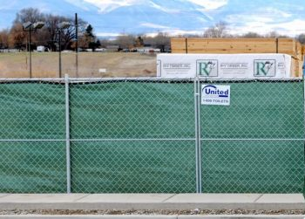
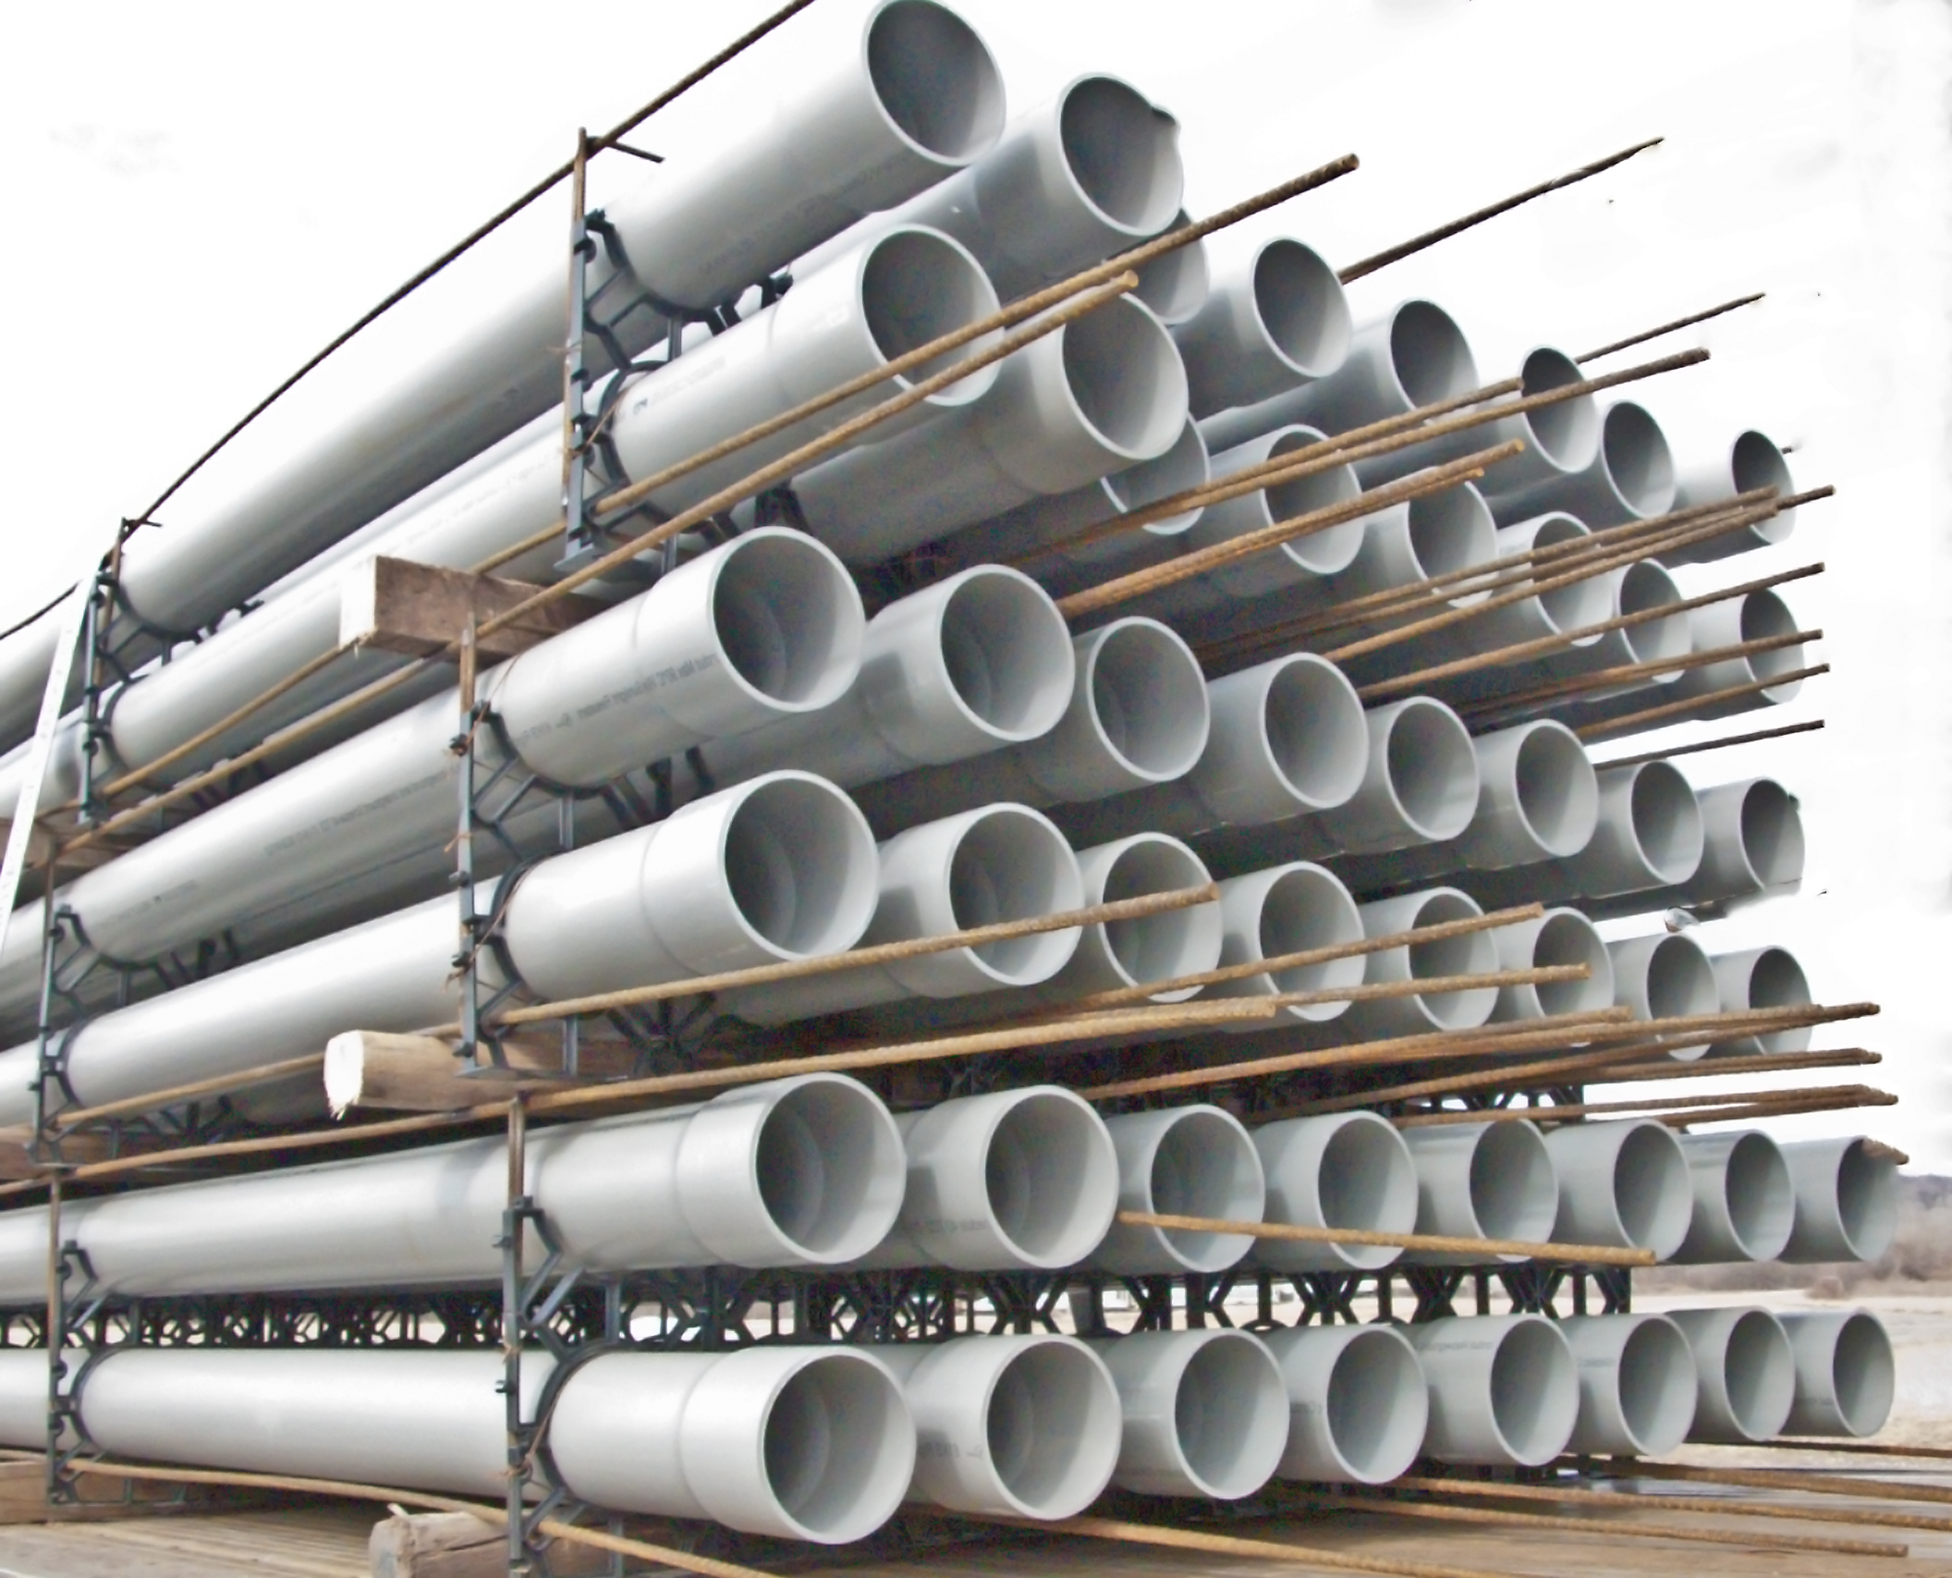

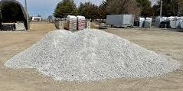
135 Fulkerson Street
Use During Project Construction (~ 2024 - 2030)
Coordinating with abutting property owners and City of Cambridge, Eversource and project contractors to use parcel to support construction of the new substation and electric transmission lines.
Existing building to be demolished. (~Mid 2024*)
Site preparation activities including stone and/or temporary paving as well fence installation.
Parcel to be used for parking as well as material and equipment storage related to GCEP. Reduce pressure on neighborhood streets and parking.
Outreach team will provide nearby residents with updates and coordinate on any larger scheduled deliveries.
Fulkerson Street
Charles Street
Fulkerson Street
* Assumes EFSB Project Approval
Photos for illustration only – exact use to be coordinated

Slide 8
135 Fulkerson Street
City Process for Parcel Use
City to purchase the property after EFSB project approval (anticipated Q3 2024)
Eversource to use property during active construction for lay down, parking, etc. and will demolish the building on-site.
City begins community process to determine future parcel use (anticipated Q2 2029)
After substation is complete and transmission lines are energized, parcel would be available for public use (anticipated Q4 2030)
Fulkerson Street
City of Cambridge
Charles Street
Fulkerson Street

Slide 9

135 Fulkerson Street
Future Use of the Parcel – Community Engagement Process
City is committed to using the parcel for public use.
We value community input in determining the parcels use.
We have heard requests for housing and open space, but there will be numerous opportunities for additional input from the community.
  Community engagement process to begin in 2029.
Participate in the process - let us know what you think!
Fulkerson Street
Charles Street
Fulkerson Street

Slide 10


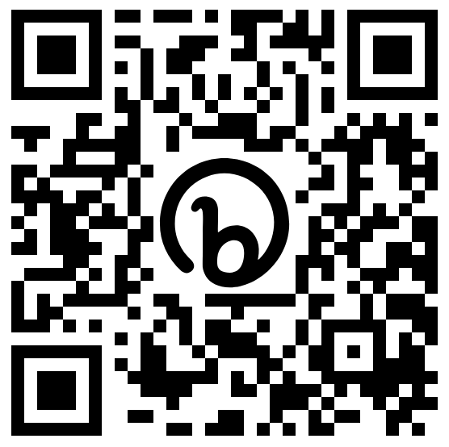
Contact Us
For More Information on the Greater Cambridge Energy Program:
1-833-836-0302
ProjectInfoMA@eversource.com
www.eversource.com/greater-cambridge-energy-program
Scan the QR Code to join our update list
For more information on the City of Cambridge public process contact:
Kristen Kelleher
kkelleher@cambridgema.gov

